Slide 2
Welcome to the World of Blockchain, Bitcoin & Digital Assets
^{John Vance}
^{CERTIFIED FINANCIAL PLANNER™}
CERTIFIED DIVORCE FINANCIAL ANALYST™
^{CA Insurance License #0C42311}
“Vance Wealth, Inc. (“Vance Wealth”) is a registered investment advisor.
Advisory services are only offered to clients or prospective clients where Vance Wealth and its representatives are properly licensed or exempt from licensure”

Slide 3
Disclosures
Vance Wealth, Inc. (“Vance Wealth”) is a registered investment advisor. Advisory services are only offered to clients or prospective clients where Vance Wealth and its representatives are properly licensed or exempt from licensure. The information provided is for educational and informational purposes only and does not constitute investment advice and it should not be relied on as such. It should not be considered a solicitation to buy or an offer to sell a security. It does not take into account any investor's particular investment objectives, strategies, tax status or investment horizon. You should consult your attorney or tax advisor.
The views expressed in this commentary are subject to change based on market and other conditions. This commentary may contain certain statements that may be deemed forward‐looking statements. Please note that any such statements are not guarantees of any future performance and actual results or developments may differ materially from those projected. Any projections, market outlooks, or estimates are based upon certain assumptions and should not be construed as indicative of actual events that will occur.
Index returns are unmanaged and do not reflect the deduction of any fees or expenses. Index returns reflect all items of income, gain and loss and the reinvestment of dividends and other income. You cannot invest directly in an Index.
No investment strategy or risk management technique can guarantee returns or eliminate risk in any market environment. All investments include a risk of loss that clients should be prepared to bear. The principal risks of Vance Wealth strategies are disclosed in the publicly available Form ADV Part 2A.
Risk associated with equity investing include stock values which may fluctuate in response to the activities of individual companies and general market and economic conditions. Although bonds generally present less short-term risk and volatility risk than stocks, bonds contain interest rate risks; the risk of issuer default; issuer credit risk; liquidity risk; and inflation risk. Investing in foreign domiciled securities may involve risk of capital loss from unfavorable fluctuation in currency values, withholding taxes, from differences in generally accepted accounting principles or from economic or political instability in other nations.

Slide 4
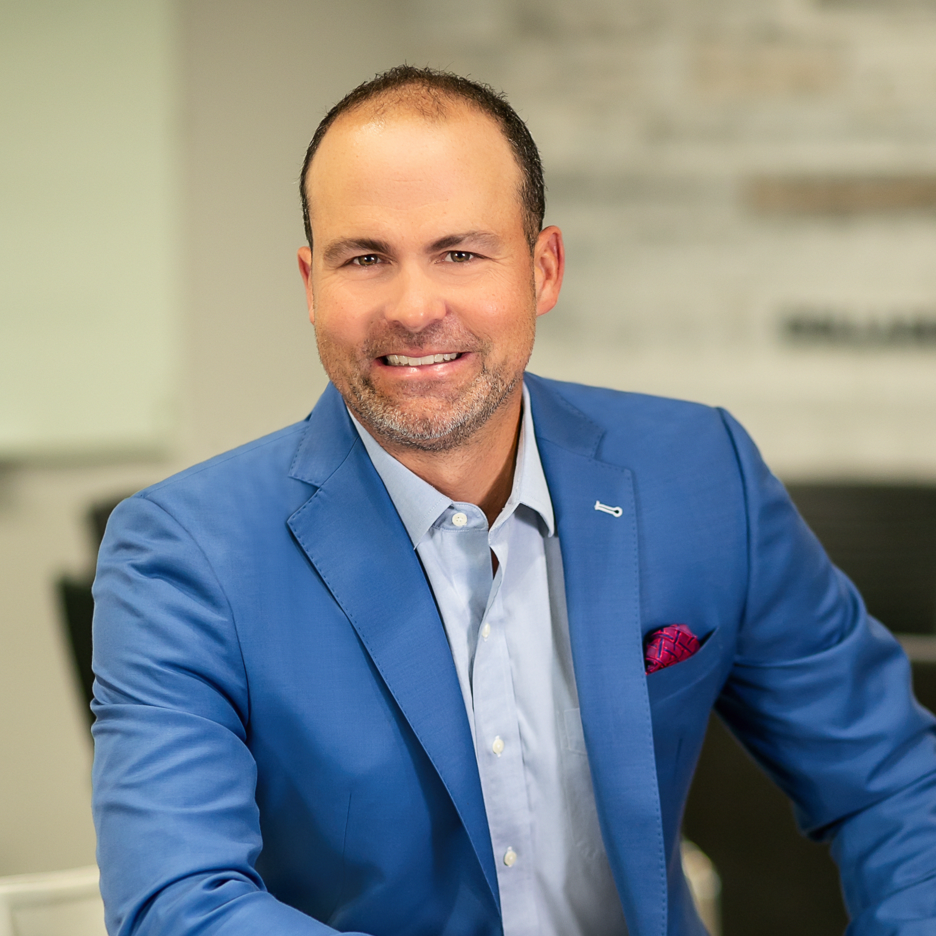
John Vance founded Vance Wealth, a premier financial planning practice with the mission to help others achieve more. As a CERTIFIED FINANCIAL PLANNER® professional and , he’s passionately committed to helping families and businesses succeed at every step of their financial journey. In the community, John serves on the board of Single Mothers Outreach and the SCV Chamber of Commerce. Outside the office, John loves spending time with his fiancé, Carmen, and their six kids.

Slide 5
Source: Digital Assets Council of Financial Professionals

Slide 6
Source: Digital Assets Council of Financial Professionals

Slide 7
Source: Digital Assets Council of Financial Professionals

Slide 8
Source: Digital Assets Council of Financial Professionals

Slide 9
Source: Digital Assets Council of Financial Professionals

Slide 10
Source: Digital Assets Council of Financial Professionals

Slide 11
Source: Digital Assets Council of Financial Professionals

Slide 12
Source: Digital Assets Council of Financial Professionals

Slide 13
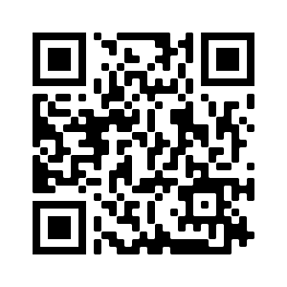
Curious about how Crypto Currency can fit into your portfolio? Schedule a 30-minute complimentary consultation.
Please scan this QR code with your phone to schedule an appointment. Or book on our website at https://vancewealth.com/book-an-appointment/
santa clarita Office 26491 Summit Circle
Santa Clarita, CA 91350
661.775.0950
Pasadena Office 226 West Mountain Street, Suite 110
Pasadena, CA 91103
888.775.0950
Like us on social media VANCEWEALTH.COM
FACEBOOK
LINKEDIN

